Slide 1
IL code generator
Compiler design principles
Dr. Saeed Parsa
Presesnter: Kawan FarhadiBaneh
12/25/2023

Slide 2
IL generation steps
Write A grammar
Generate A Lexer and Parser from your grammar
Write your input and a script that specifies the flow of your program (main script)
Write a custom listener to generate Abstract syntax tree (AST) from parse tree
If your AST is binary, transform it to a normal AST
Perform post-order traversal on your AST and store it.
Generate IL code from the post-order traversal of the AST
Write the IL code to a file with “.il” extension
Use ilasm.exe to produce an executable file for your “.il” file
Run your executable file

Slide 3
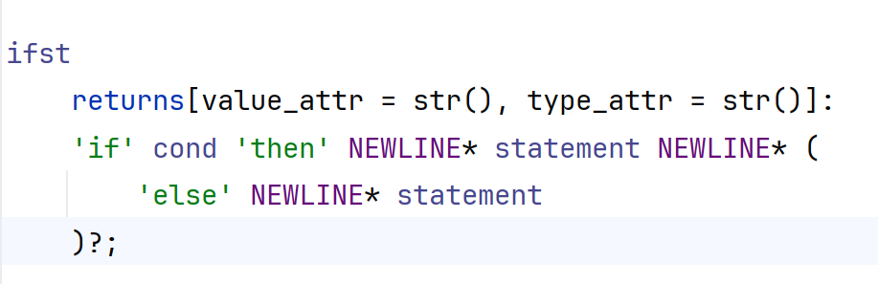
Grammar
Grammar is used to define the rules that should be followed, and default lexer and parser can be generated from it.

Slide 4

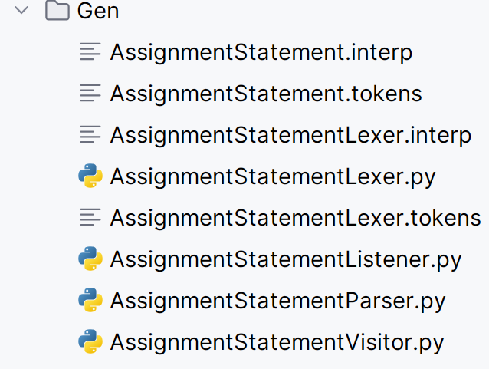
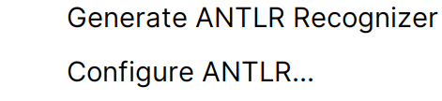
Default Lexer and Parser

Slide 5
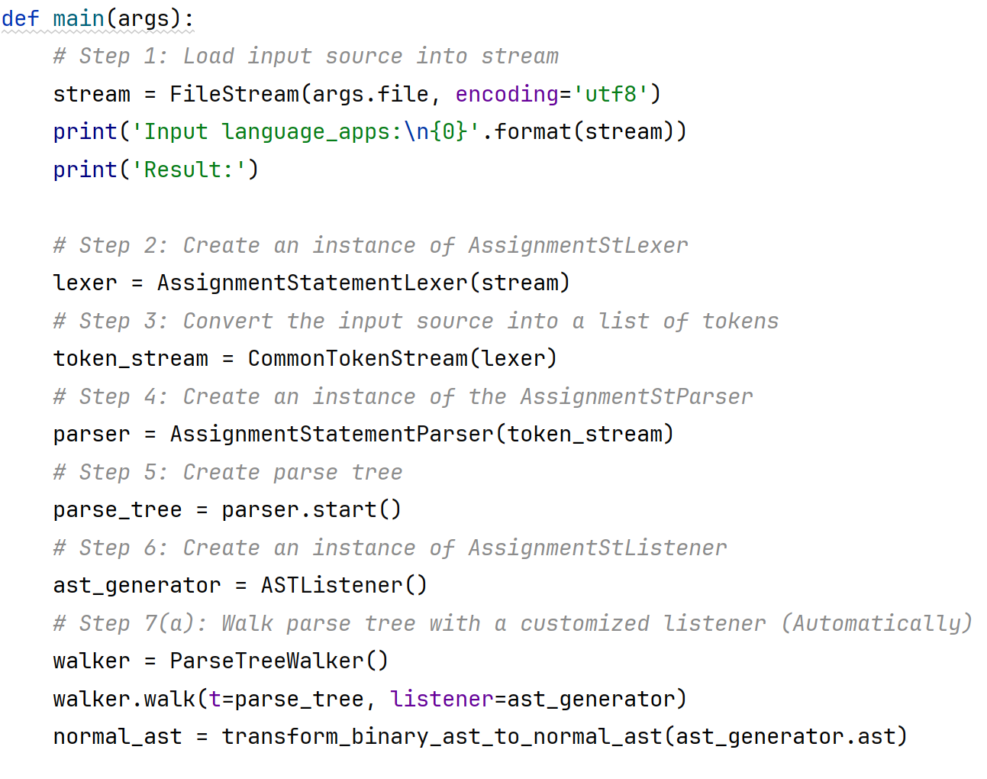
Main script
This script determines the flow of our application

Slide 6
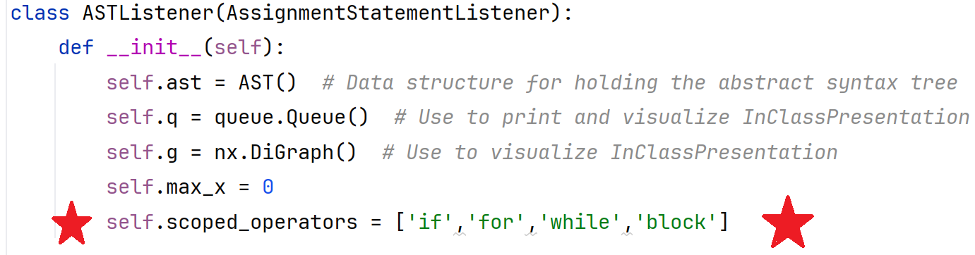
Custom Listener
By using a custom listener and overriding the exit and enter functions of its parent we can define actions to be taken when traversing the parse tree when using a walker and by we can produce the desired results.

Slide 7
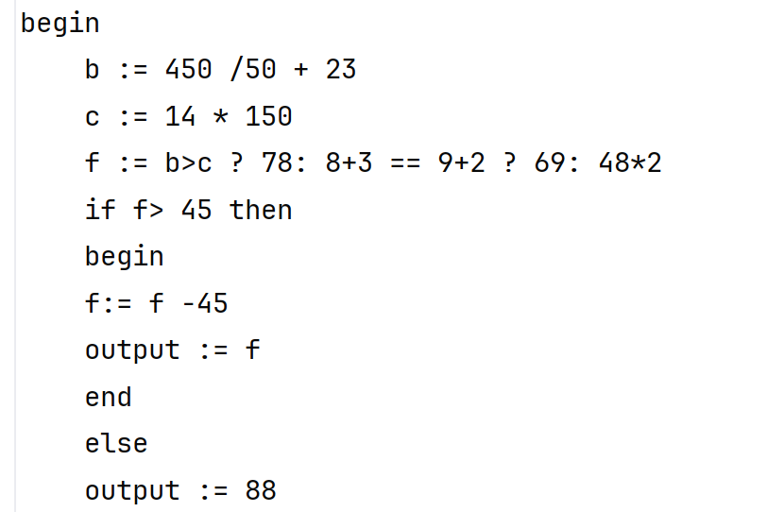
Example input

Slide 8
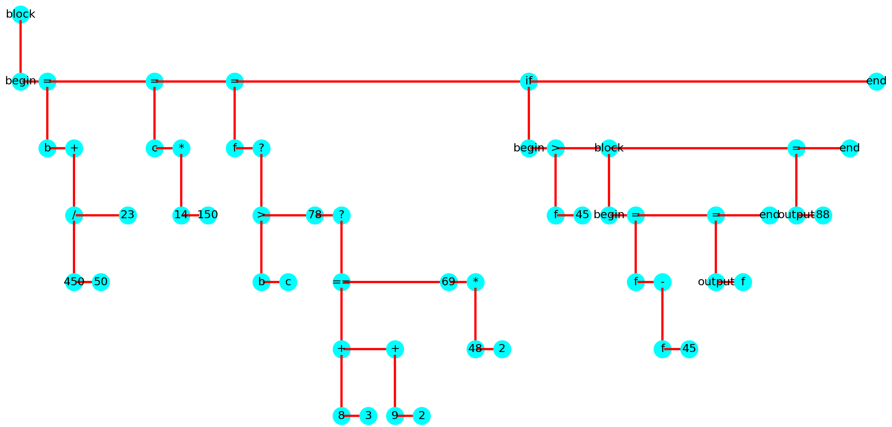
Binary AST

Slide 9
Binary to normal AST transformation
Post order traversal of our custom binary tree requires a custom algorithm to be done. By transforming the Binary AST to Normal AST we can achieve the same result using standard libraries defined in networkx library in python.

Slide 10
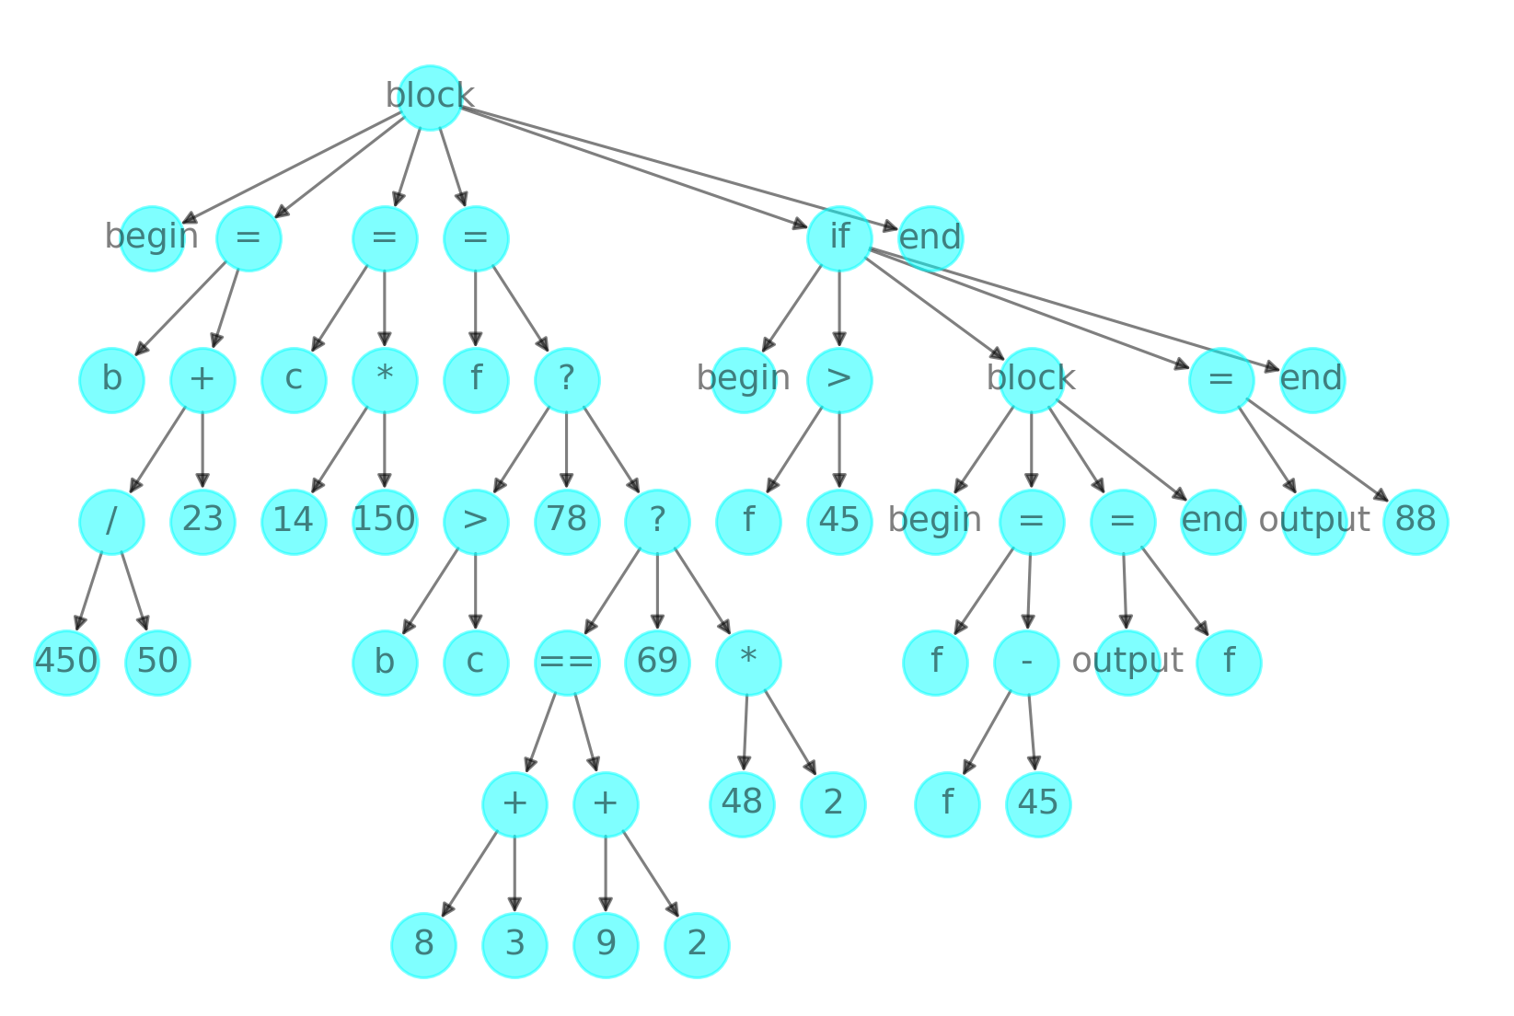
Normal AST

Slide 11
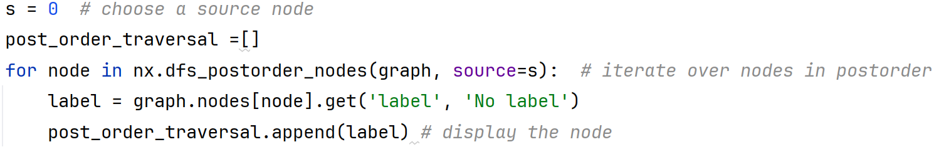
Post-order traversal of AST
Using the resulting post-order traversal we can generate IL code.
We prefer using post-order traversal because the operands are visited before the operators, which is similar to how most ILs are structured

Slide 12
Post-order traversal
['begin’,
'b’, '450’, '50’, '/’, '23’, '+’, ‘=‘,
'c’, '14’, '150’, '*’, ‘=‘,
'f’, 'b’, 'c’, '>’, '78’, '8’, '3’, '+’, '9’, '2’, '+’, '==‘, '69’, '48’, '2’, '*’, '?’, '?’, ‘=‘,
'begin’, 'f’, '45’, ‘>’,
'begin’, ‘f’, 'f’, '45’, '-’, '=‘, 'output’, 'f’, '=‘, 'end’, 'block’,
'output’, '88’, '=‘, 'end’, 'if’,
'end’, 'block’ ]

Slide 13

Using the ILMapper class from main

Slide 14
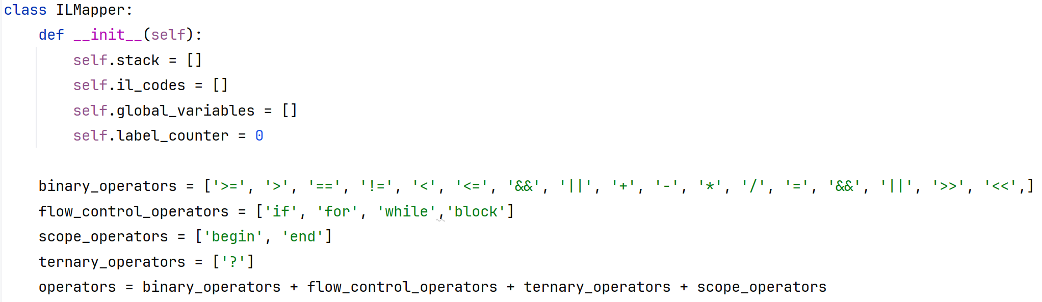
ILMapper class

Slide 15
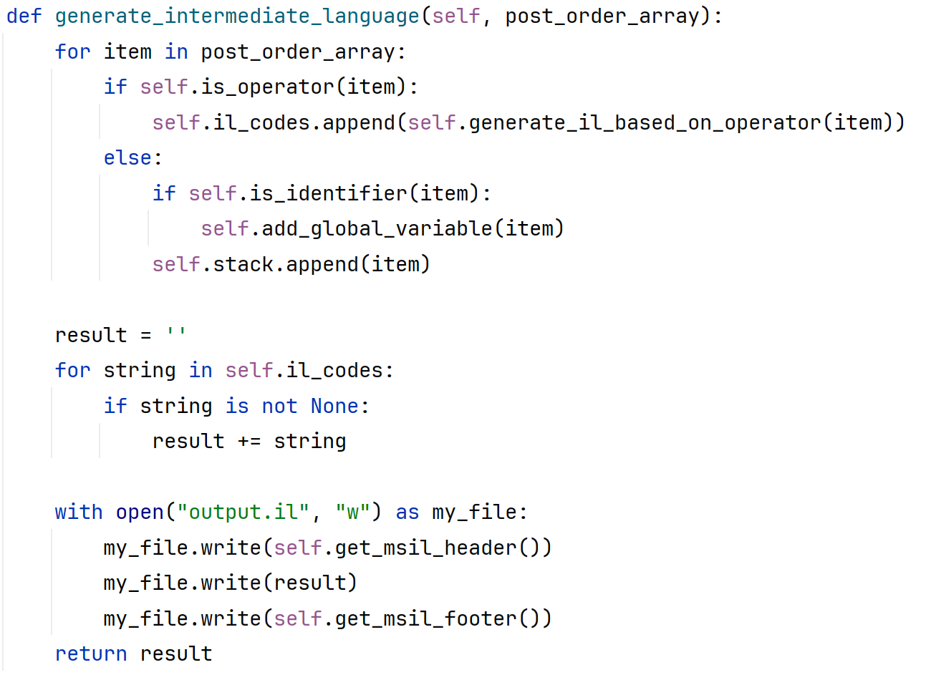
ILMapper Core functions

Slide 16
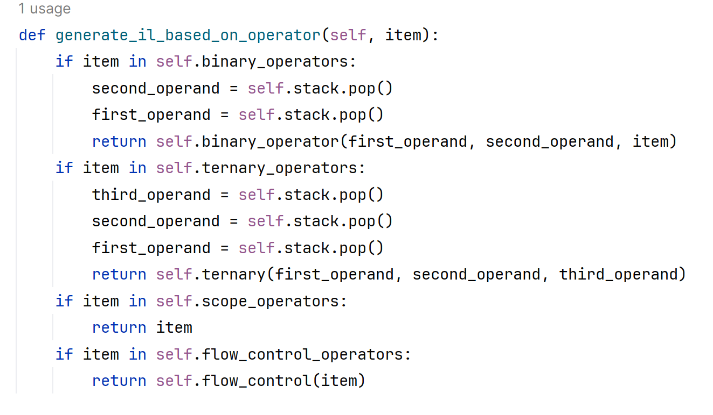
ILMapper Core functions

Slide 17
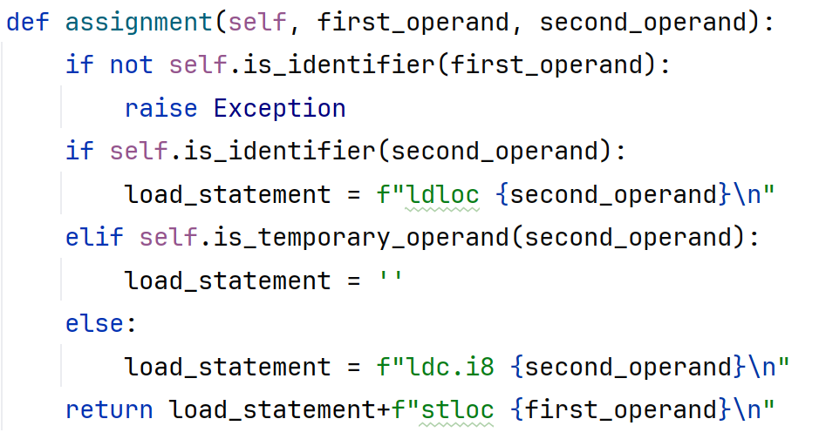
ILMapper code generation for assignment

Slide 18
ILMapper code generation example:
'b’, '450’, '50’, '/’, '23’, '+’, ‘=‘,
ILMapper stack
b
ILMapper il_codes
IL Runtime Stack

Slide 19
ILMapper code generation example:
'b’, '450’, '50’, '/’, '23’, '+’, ‘=‘,
ILMapper stack
450
b
ILMapper il_codes
IL Runtime Stack

Slide 20
ILMapper code generation example:
'b’, '450’, '50’, '/’, '23’, '+’, ‘=‘,
ILMapper stack
50
450
b
ILMapper il_codes
IL Runtime Stack

Slide 21
ILMapper code generation example:
'b’, '450’, '50’, '/’, '23’, '+’, ‘=‘,
ILMapper stack
50
450
b
ILMapper il_codes
ldc.i8 450 ldc.i8 50 div
IL Runtime Stack
50
450

Slide 22
ILMapper code generation example:
'b’, '450’, '50’, '/’, '23’, '+’, ‘=‘,
ILMapper stack
b
ILMapper il_codes
ldc.i8 450 ldc.i8 50 div
IL Runtime Stack
50
450

Slide 23
ILMapper code generation example:
'b’, '450’, '50’, '/’, '23’, '+’, ‘=‘,
ILMapper stack
__Temporary
b
ILMapper il_codes
ldc.i8 450 ldc.i8 50 div
IL Runtime Stack
9

Slide 24
ILMapper code generation example:
'b’, '450’, '50’, '/’, '23’, '+’, ‘=‘,
ILMapper stack
23
__Temporary
b
ILMapper il_codes
ldc.i8 450 ldc.i8 50 div
IL Runtime Stack
9

Slide 25
ILMapper code generation example:
'b’, '450’, '50’, '/’, '23’, '+’, ‘=‘,
ILMapper stack
23
__Temporary
b
ILMapper il_codes
ldc.i8 450 ldc.i8 50 div
ldc.i8 23 add
IL Runtime Stack
23
9

Slide 26
ILMapper code generation example:
'b’, '450’, '50’, '/’, '23’, '+’, ‘=‘,
ILMapper stack
b
ILMapper il_codes
ldc.i8 450 ldc.i8 50 div
ldc.i8 23 add
IL Runtime Stack
23
9

Slide 27
ILMapper code generation example:
'b’, '450’, '50’, '/’, '23’, '+’, ‘=‘,
ILMapper stack
__Temporary
b
ILMapper il_codes
ldc.i8 450 ldc.i8 50 div
ldc.i8 23 add
IL Runtime Stack
32

Slide 28
ILMapper code generation example:
'b’, '450’, '50’, '/’, '23’, '+’, ‘=‘,
ILMapper stack
__Temporary
b
ILMapper il_codes
ldc.i8 450 ldc.i8 50 div
ldc.i8 23 add
stloc b
IL Runtime Stack
32

Slide 29
ILMapper code generation example:
'b’, '450’, '50’, '/’, '23’, '+’, ‘=‘,
ILMapper stack
ILMapper il_codes
ldc.i8 450 ldc.i8 50 div
ldc.i8 23 add
stloc b
IL Runtime Stack
32

Slide 30
ILMapper code generation example:
'b’, '450’, '50’, '/’, '23’, '+’, ‘=‘,
ILMapper stack
ILMapper il_codes
ldc.i8 450 ldc.i8 50 div
ldc.i8 23 add
stloc b
IL Runtime Stack

Slide 31
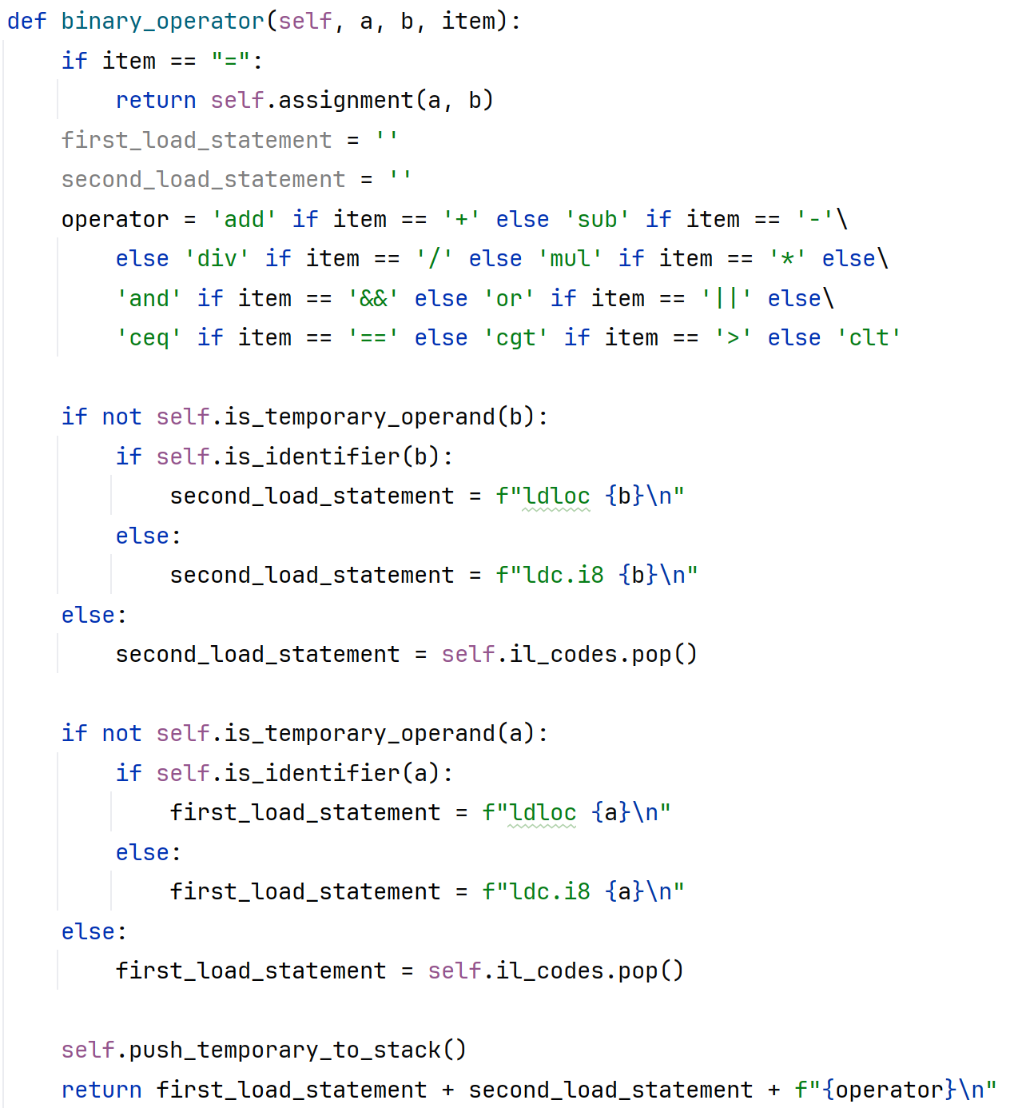
ILMapper code generation: binary operator

Slide 32
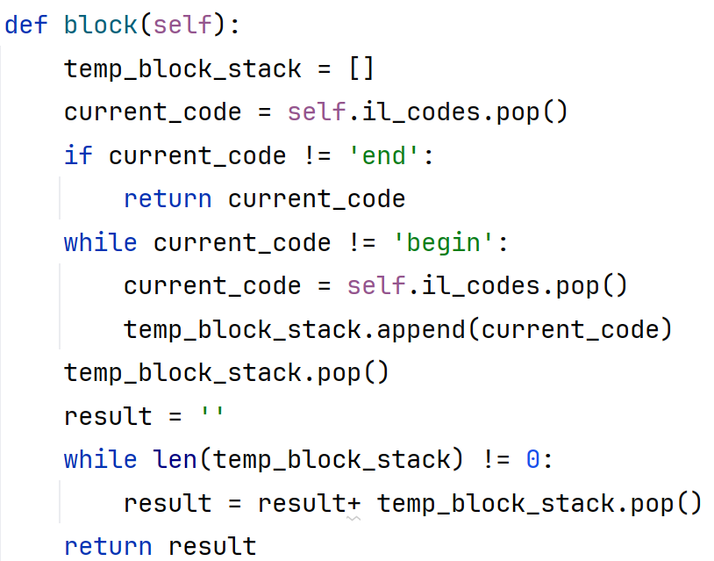
ILMapper code generation: block

Slide 33
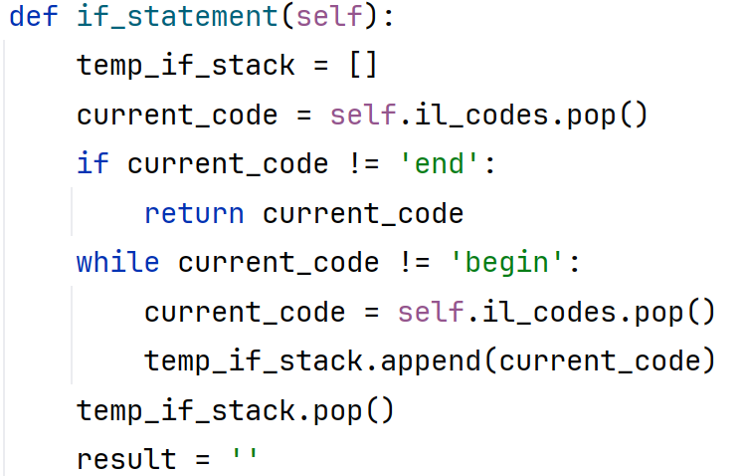
ILMapper code generation: if

Slide 34
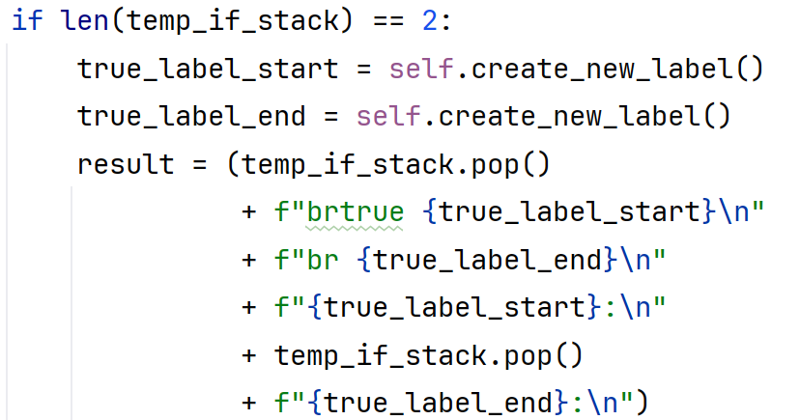
ILMapper code generation: if without else part

Slide 35
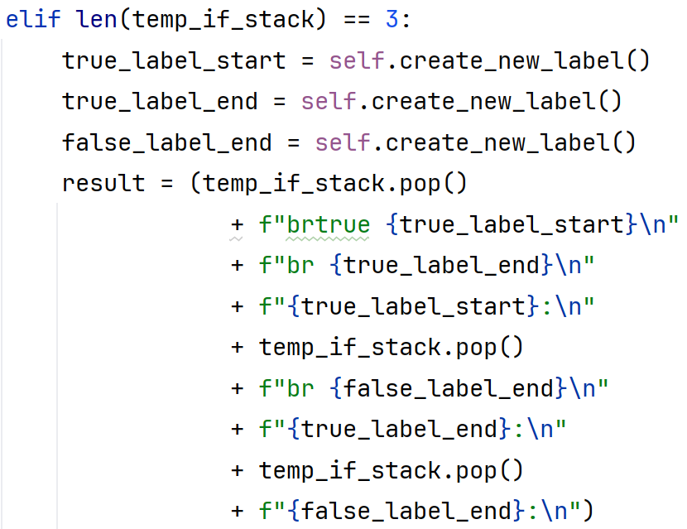
ILMapper code generation: if with else part

Slide 36
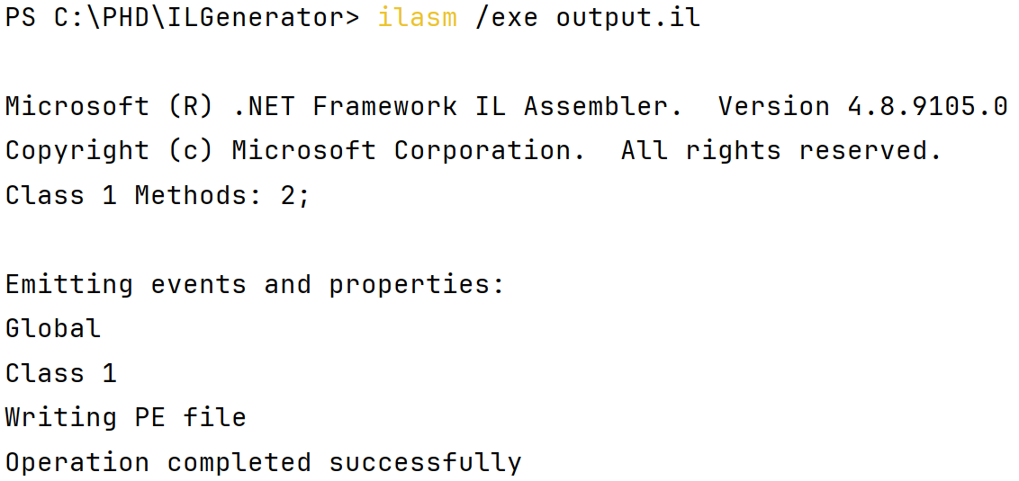
ilasm: command for building EXE file

Slide 37

command running EXE file in windows

Slide 38
Homework:
Add code generation functionality for the following:
For loops
While loops
Greater than or equal to operator (“>=“)
Less than or equal to operator (“<=“)
Not equal to operator (“!=“)
The deadline for this homework is due on Saturday, 8th of Dey, 1402 (01/01/2024)

